Slide 1
ROAD ACCIDENTS PREVENTION
USING IOT

Slide 2
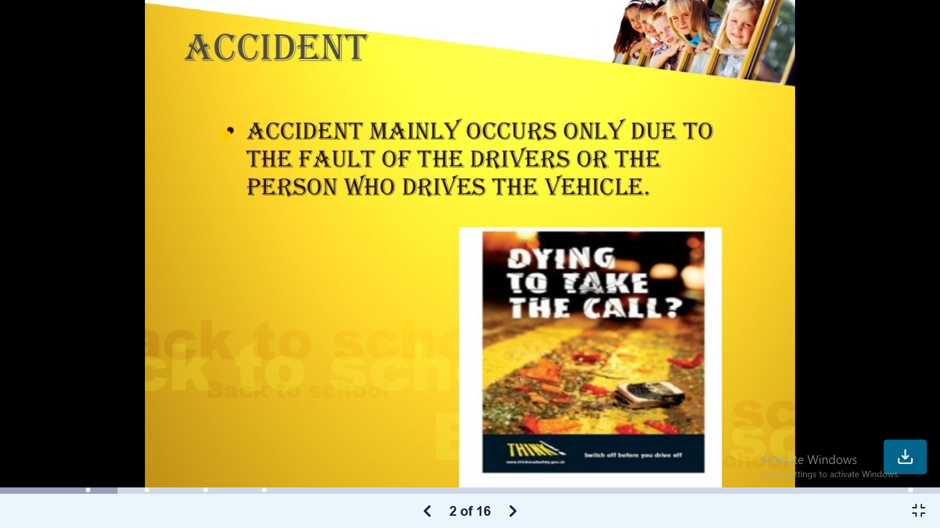

Slide 3
Accidents may happen due to
Over speed
While speaking in the phone.
Not following traffic rules.
Drunk and Drive
Unconscious/Feeling Drowsy
Teens/inexperienced Rash Driving

Slide 4
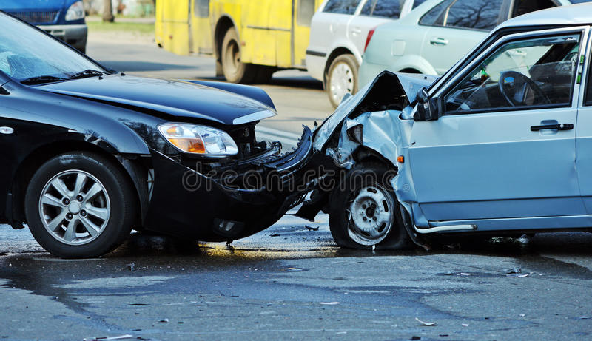
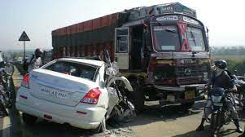
Some Images

Slide 5
Road Accident Statistics
Road accidents : A leading cause of Injuries,Deaths & Disabilities.
more than 1.2 million people are killed in road accidents.
India : 2020
Accidents : 3,54,796
Deaths :1,33,201
person injuried : 3,35,201
In every day :
1214 Accidents/day and 377 people died/day
17 accidents/hour

Slide 6
Preventions to reduce road accidents / TO minimize Severity
Drive in the prescribed speed limits on the various roads.
Always put on helmets, seat belts and other safety equipment before driving a bicycle/ motor cycle/vehicle.
Do not drink and drive.
Never use mobile phones or ear phones while driving.
Zebra crossing should be provided
One way traffic should be implemented
All the rules should be followed by people.

Slide 7
Disadvantages
Property damage
Back and Spine injuries
Death
Anxiety
Depression

Slide 8
An IOT Based Smart System for Accident Prevention and Detection
OVERVIEW:
Bike accidents constitute a major chunk of all accidents
As Two-wheelers do not have as many safety parameters which are included in four-wheelers.
25% Accedents are bike accidents
Two wheelers are mostly used as they are available in affordable Prices

Slide 9
System Comprised Of
Validating Driving License
Smart Helmet
Eye Blinking Monitoring System(EBM)
Unintended acceleration and pedal mix-up Verification
Red signal Detection
V2V Communication
Client Server Architecture

Slide 10
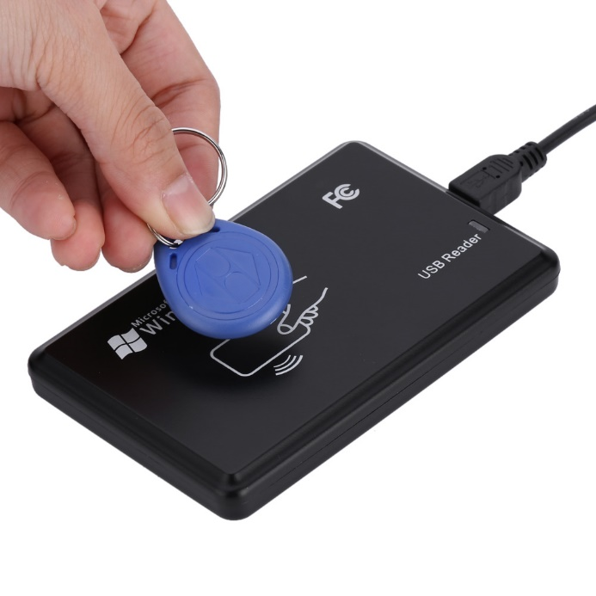
Validating Driving License
Accidents involving ineligible drivers are huge in number.
To validate the driver by viewing his driving license •
The RFID reader on the bike will have will have at most 10 registered users, so that the family members or his/her friends can also ride the bike. Hence, this mechanism also handles theft related issues.
This is done by using RFID which will be on the driving license and the RFID reader on the bike’s front panel.

Slide 11
SMART Helmet
Features
Sensors
Accelerometer
Pressure Sensor
RFID
RF receiver
RF Transmitter
GPS
GSM module
prevent a drunk person from driving
identify accident if any
Make Sure to wear Helmet

Slide 12
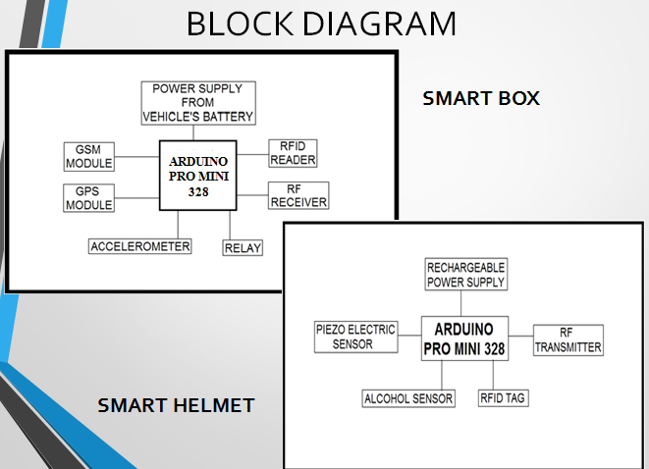

Slide 13
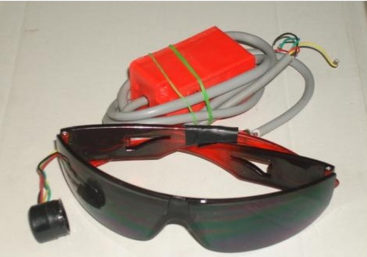
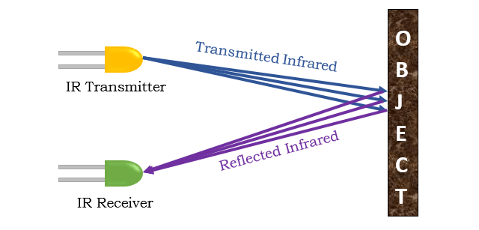
EYE BLINKINg monitoring system(ebm)
IR sensors monitors the blinking patterns of the driver
light gets more reflected when we close our eyes than when we keep our eyes open.

Slide 14
acceleration and pedal mix-up Verification
Unintended acceleration and pedal mix-up is also one of reasons causing fatal accidents
It checks whether the driver is drowsy or not
The system keeps track of the acceleration patterns of the person
Involuntarily triggers the acceleration pedal instead of the brake pedal
The system design is capable of turning that acceleration into deceleration gradually.

Slide 15
Signal Verification
camera fit on the front of the bike
monitor whether the traffic signal displayed is red or not,
automatic braking system will gradually reduce the speed of the bike.
automatically cause deceleration.

Slide 16
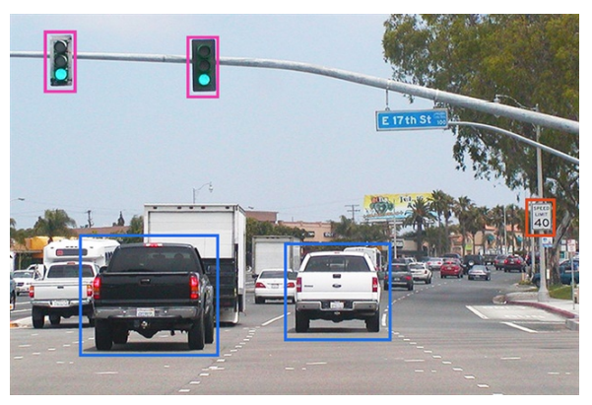
Vehicle to vehicle communication
The ultrasonic sensor used continuously keeps track of the distance maintained between any two vehicles.
If greater than threshold, immediately warn both drivers using V2V communication
sends messages to that vehicle wirelessly through a well-established server.
reducing noise pollution
concerned people will be alerted without disturbing the others

Slide 17
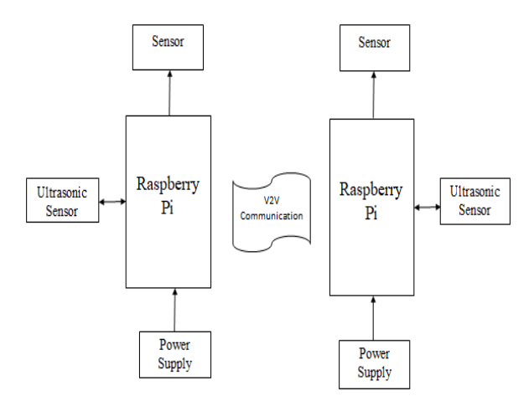
Block Diagram

Slide 18
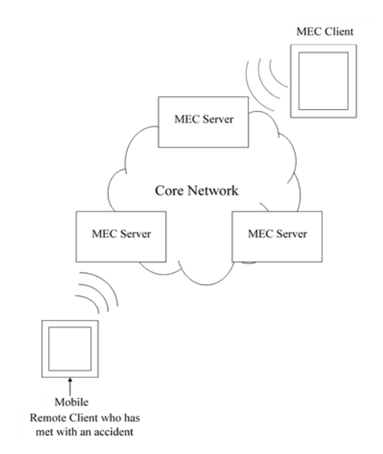
Client Server Architecture
When the accident occurs it uses MEC for avoiding secondary traffic accident and sending message to nearby hospitals for help
efficient to message the neighboring vehicles for even faster response

Slide 19
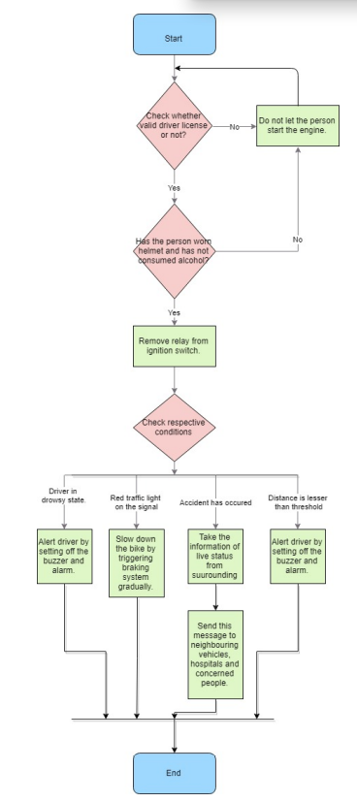

Flow chart

Slide 20
resources
Driver Drowziness Detection System with Gsm Alert using Piezoelectric Sensor – IJERT
Smart Helmet With Message Alert System – IJERT
An IOT Based Smart System for Accident Prevention and Detection | IEEE Conference Publication | IEEE Xplore

Slide 21
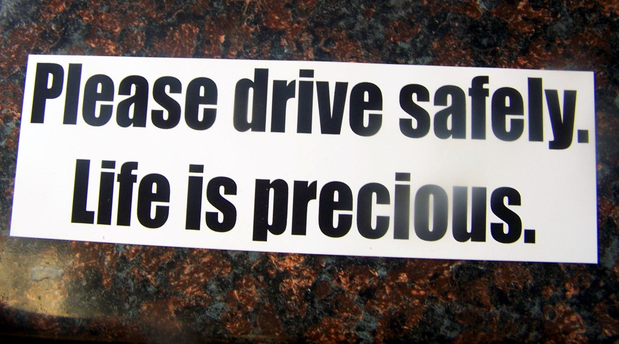
THANK YOU
Presented By
S160043
S160423

